Slide 1
H2Cloud: Maintaining the Whole Filesystem in an Object Storage Cloud
Minghao Zhao
Zhenhua Li
✉️
Ennan Zhai
Gareth Tyson
Qian Chen
Zhenyu Li
Leiyu Zhao
zhaominghao.thu@gmail.com; lizhenhua1983@gmail.com
http://www.greenorbs.org/people/lzh
ICPP’18, Aug. 16th 2018

Slide 2
Outline
1
Background
2
State of the Art
3
Index Structure Design
4
Prototype system
5
Performance Evaluation
6
Summary

Slide 3
Background
The enormous growth of objective cloud storage;
eg., Aliyun OOS, OpenStack Swift, Amazon S3.
High usability;
eg, simple flat data object operations like PUT, GET and DELETE.
cost-effectiveness;
i.e., low unit price of storing/accessing data.
functional gap between the flat object storage cloud and hierarchical directory structures
requiring a secondary sub-system to map a hierarchical filesystem into the flat object storage.
Notes:
Recent years have seen enormous growth of the object storage clouds, such as and Aliyun OSS, OpenStack Swift and Amazon S3.
This is mainly due to its unique advantage of high usability, such as it provides simple flat data object operations like PUT, GET and DELETE, and because of its cost-effectiveness.
The simplicity, however, is also a weakness, as it forces users to translate familiar hieratical file directory transactions into flat operates.
As the functional gap between the flat object storage cloud and hierarchical directory structures,
applications wishing to use file-based abstraction are required to build a secondary sub-system that maps a hierarchical filesystem into the flat object storage offered..

Slide 4
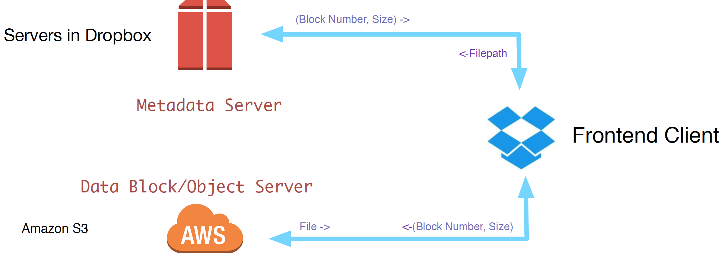
An Example of Dropbox
use two clouds to host the user’s file content and directories separately.
incurs additional cost and effort for achieving high data reliability and scalability
Notes:
As an example of Dropbox, it provided a tree structure filesystem to their users, but the storage platform it relayed on only provides flat operates such as PUT, GET and DELETE.
As a solution, it requires two clouds to store the file content and directories separately – a data object server to store the user’s files and a metadata server to maintain the index map.
This architecture is adopted by most of mainstream cloud services.
Obviously, this solution incurs additional cost and effort for achieving high data reliability and scalability,
and it generally taken that, the large scale data loss happened in the year 2013 is related to the reliability problem of the index cloud .

Slide 5
A challenging question
Can we use an object storage cloud to efficiently host both the file content and directories?
Notes:
If the answer is positive, we can re-take advantage of the object storage cloud to automatically provide high reliability and scalability for directories without additional efforts

Slide 6
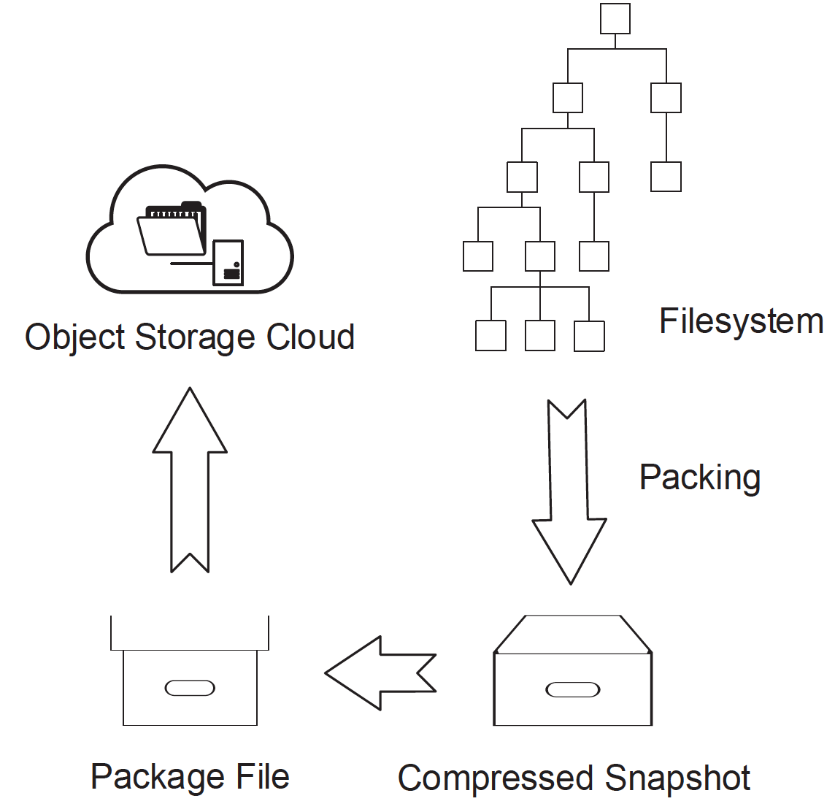
Background
Compressed Snapshot
e.g. Cumulus
packs; compresses; flattens
terrible overhead for random
access
Content Addressable Storage (CAS)
e.g, Foundation, Venti and Camlistore
data locations are tightly coupled with the data content
also only suitable for backups, rather than real file system.
Notes:
As a suitable data structure is the key to efficiently maintaining users’ filesystems in an object storage cloud, we wonder whether there are any solution-based publicly-available techniques that can answer our question.
Thus, we surveyed representative data structures coupled with relevant storage systems, to investigate weather they can accomplish our goals.
The first one is Compressed Snapshot, which is adopted by the Cumulus. It packs and compresses the content of files to several Segments, and meanwhile flattens the directories to a one-dimensional list.
However, it has to traverse the whole snapshot so as to locate a file in the filesystem, which leads to terrible overhead for random access.
The Content Addressable Storage organized the data in which data locations are tightly coupled with the data content. Similar to the snapshot, Itis also only suitable for backups, rather than real file system.

Slide 7
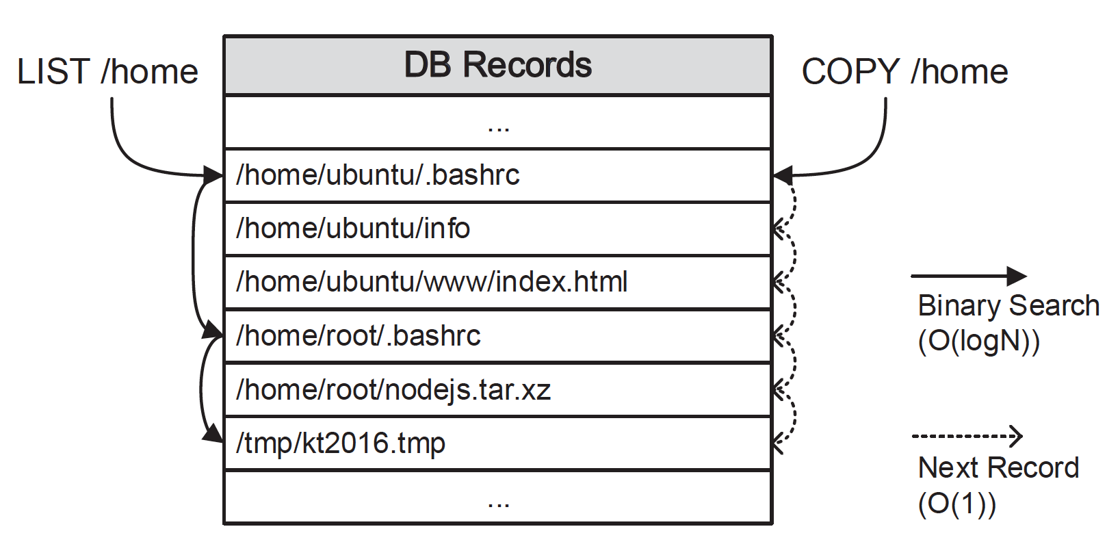
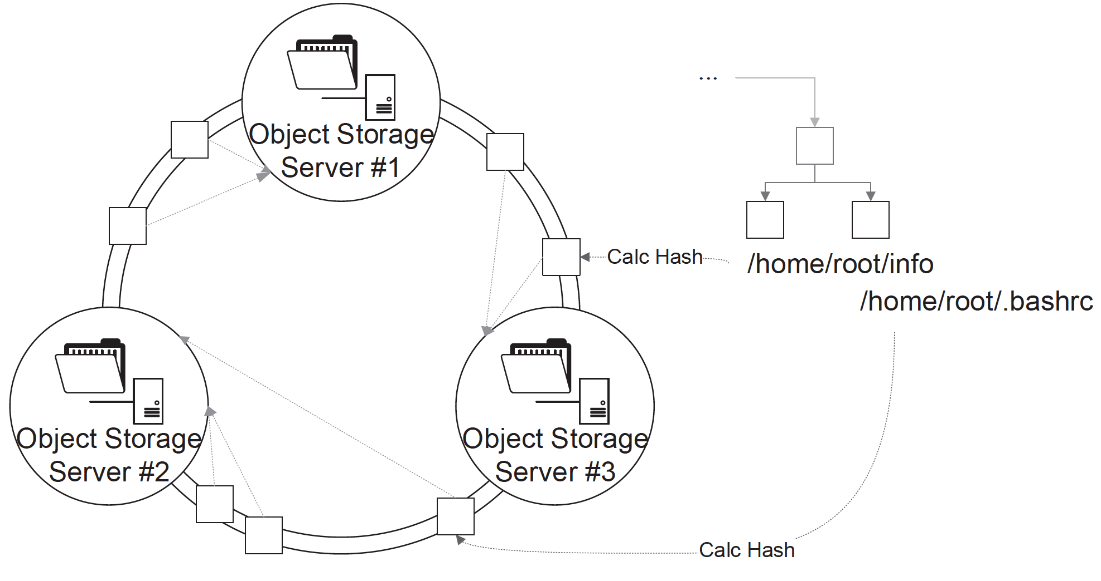
State of the art (metadata management)
Consistent Hash
hash the full path
locate file in a hash ring
efficient for file access
inefficient for others
File Path DB
for acceleration
additional
sub-systems
Notes:
The consistent hash hashes the full file path and locates a file in a consistent hash ring.
It is efficient for file access, but in-efficient for other operations such as LIST,COPY and MOVE, as these operations requires traverse the whole hash ring.
An effective method for accelerate these operations is to use a file path DB, which uses the binary search to improve the performance of the operations witch formerly requires the sequential search.
Nevertheless, Getting rid of the usage of these secondary sub-systems is a core goal of our work.

Slide 8
Single Index Server
e.g., GFS and Hadoop
limited scalability
Static Partition
e.g., The Andrew File System and NFS
extreme simplicity
inefficient for filesystem operations with different partitions involved
Dynamic Partition (DP) &DP on Shared Disk.
e.g., Ceph, GIGA+; BlueSky, xFS
dynamically partition the directories into the index servers
requires strong consistency.
Notes:
The single index server architecture, adopted by the Google file system and the Hadoop;
obviously. the centralized architecture results in limited scalability
Static Partition, adopted by the Andrew File System and NFS statically partitions different users’ files into different object storage servers.
It has been widely adopted by light-weight filesystems for its extreme simplicity.
but the statically partitioned files and directories have the negative effect on filesystem operations with different partitions involved.
The Dynamic Partition (DP) keeps multiple index servers and dynamically partition the directories into the index servers with sophisticated load-balance algorithms,
The DP on Shared Disk requires strong consistence, which is considered unsuitable for distributed cloud storage systems, which usually sacrifice strong consistency for partition tolerance.

Slide 9
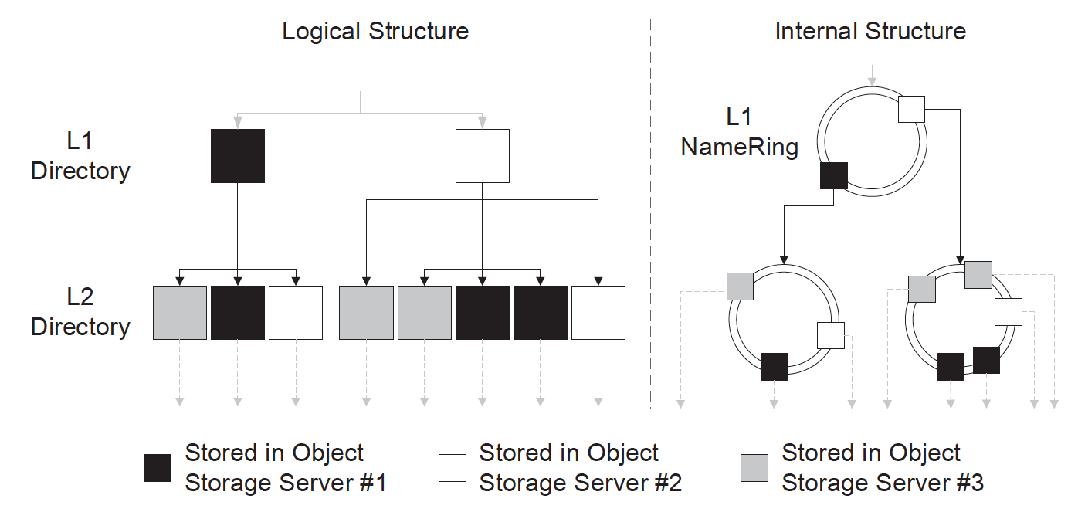
Index structure design
transform full directory path into namespace-decorated relative path
/home/ubuntu/file1 N02::file1.
each namespace (directory) possesses a NameRing
(child₀, t₀), (child₁, t₁), … , (child_{m−1}, t_{m−1})
store each NameRing in an consistent hash ring
Notes:
As we haves seen that, the aforementioned structures are unsuitable for our goals, we design the Hierarchical Hash to efficiently maintain the whole filesystem in an object storage cloud.
Now I will use an example to explain our designed structure.
Suppose a user Alice wants to maintain her Ubuntu filesystem in an object storage cloud.
First, we translate each full directory path in Alice’s filesystem to a namespace-decorated relative path.
Each namespace (directory) possesses a NameRing, which is the data structure we use to maintain a list of all files in the directory。
The nameRing records the information of the children and the timestamp of the directory.
And finally, all the NameRing is stored in a in a single, larger consistent hash ring as an object.
In this way, the hierarchical file system is transform to structured NameRing and stored in objective cloud.

Slide 10
File Access
Given a (namespace-decorated) relative path N02::file1
directly hash the relative path to locate the file in the consistent hashing ring;
achieved in O(1).
Given a full file path with a directory depth of d /home/ubuntu/file1
locate the file level by level along d NameRings;
achieved in O(d)
Notes:
We provide two cases for access a specific file.
When given a relative path, we just directly hash the relative path to locate the file in the consistent hashing ring;
it can be accomplished in constant time.
when given a full file path, we locate the file level by level along d NameRings;
that is, we use the name of a Level- 1 (L1) directory to locate the NameRing that includes all names of the direct children under the L1 , and uses the name
of an L2 directory to locate the NameRing of the L2 directory. It repeats until the desired file is reached.

Slide 11
NameRing Maintenance
Adopt synchronous updating protocol
strong consistency, poor data availability;
distributed locks leads to performance bottlenecks.
Our Method asynchronous updating protocol
Submit a patch for the modified NameRings;
patches merging within the node who submits them;
coordination among all the nodes (Gossip flooding).
Concurrency Avoidance.
Fake operation
dealing with operation like DELETE
Blocking.
dealing with I/O stream
Detailed in our paper
Notes:
When a directory is updated due to the creation of a new child or the deletion of an existing child, the corresponding NameRing is also required to be modified.
Although we can adopt synchronous updating protocol, this requires strong consistency, which leads to poor data availability,
And the synchronous update need distributed locks to enable the serialization of filesystem operations, which bring performance bottlenecks to filesystem operations.
Thus we design an asynchronous updating protocol for for effective NameRing maintenance.
Our protocol using patch submission for modifying a NameRing.
This protocol include two phases --patches merging within the node who submits them; and coordination among all the nodes.
We also design mechanisms to avoid the potentially accompanied concurrency problem,
this include fake operation, which is designed for dealing with operation like DELETE,
and Blocking which is designed for dealing with I/O stream.
The detail of the NameRing maintenance protocol is specified in our paper, and we will not explain them in this presentation.

Slide 12
H2Cloud: The porotype system
The system architecture of H2Cloud
Notes:
Based on the design of H2, we implement an open-source prototype system, the H2Cloud, on top of OpenStack Swift.
We adopts OpenStack Swift as the underlying object storage cloud because it is a widely used, open-source, and the de
facto standard of state-of-the-art systems.
The H2cloud provides the users storage in the form of web service.

Slide 13
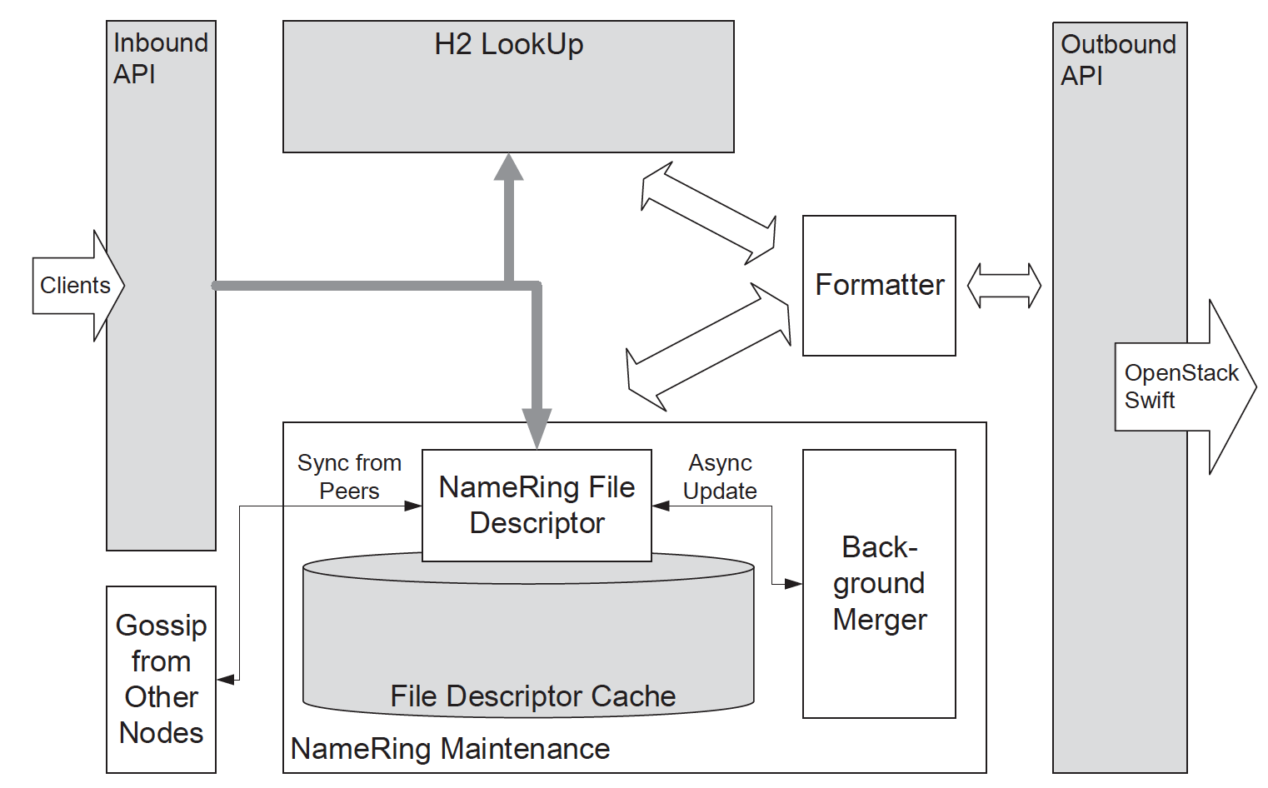
H2Cloud: The porotype system
Components within an H2Middleware.
Notes:
The H2Middleware is the key component of the H2Cloud.
It implements the H2 data structure, the file access algorithm, and the NameRing maintenance protocol.
For the users, H2Middleware serves as a proxy that provides web APIs for filesystem operations; and for the object storage cloud, H2Middleware acts as a client that invokes object operations.
As demonstrated in this slice, the Inbound and Outbound API provide basic HTTP connections with the clients and the object storage cloud.
The H2 Lookup module executes the file access algorithm and the NameRing Maintenance module implements the NameRing Maintenance protocol, the formatter is designed for stringfy-ing different types of data into string-style objects, so that these data can be easily hosted in the object storage cloud.

Slide 14
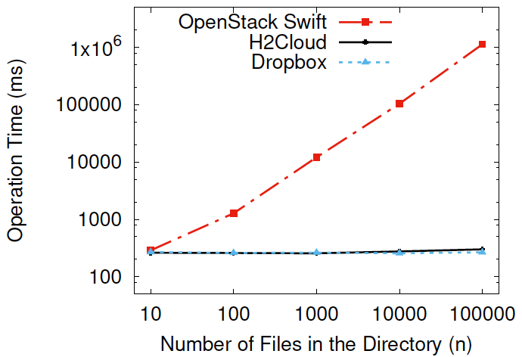
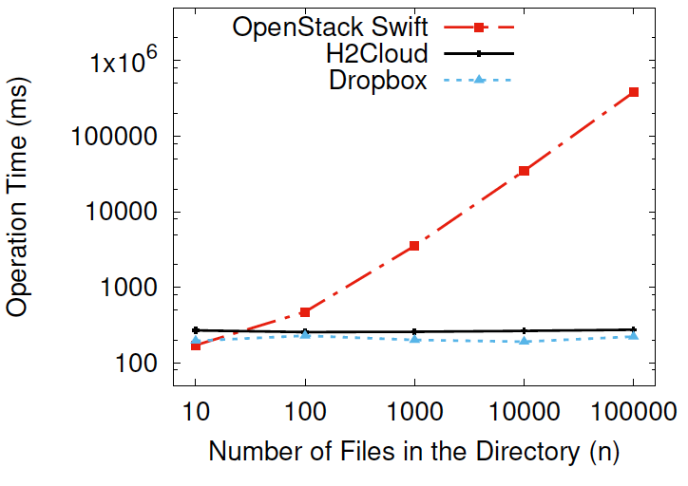
Performance evaluation
Operation time for
MOVE and RENAME.
Operation time for
MKDIR.
Notes:
In terms of the performance of the h2cloud,
here is the operation time of move, re-name and make directory with different number of files in the current directory.
It is clear to see that, the operation time stays almost unchanged for H2Cloud and Dropbox but grows exponentially for the OpenStack Swift.

Slide 15
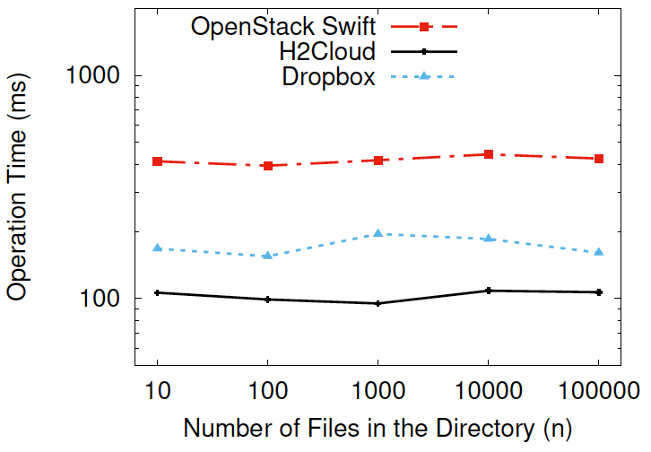
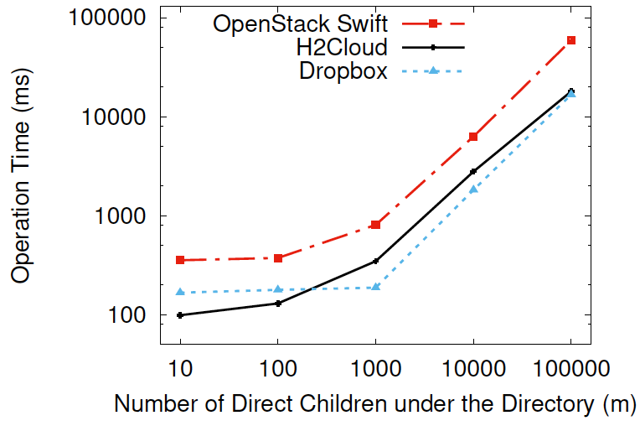
Performance evaluation
Operation time for LIST
List operation only depends on the umber of direct children
rather than the total number of files in this directory.
Notes:
Here is performance of List operation with detailed information of each file.
The horizontal axis is the number of files in the directory and the number of direct children under the current directory.
Here the direct children denote only the current-level files and sub-directories in a directory. It can be seen that the operation time of list only depends on the number of direct children under the current directory, and H2Cloud requires relatively less time for handling List operation

Slide 16
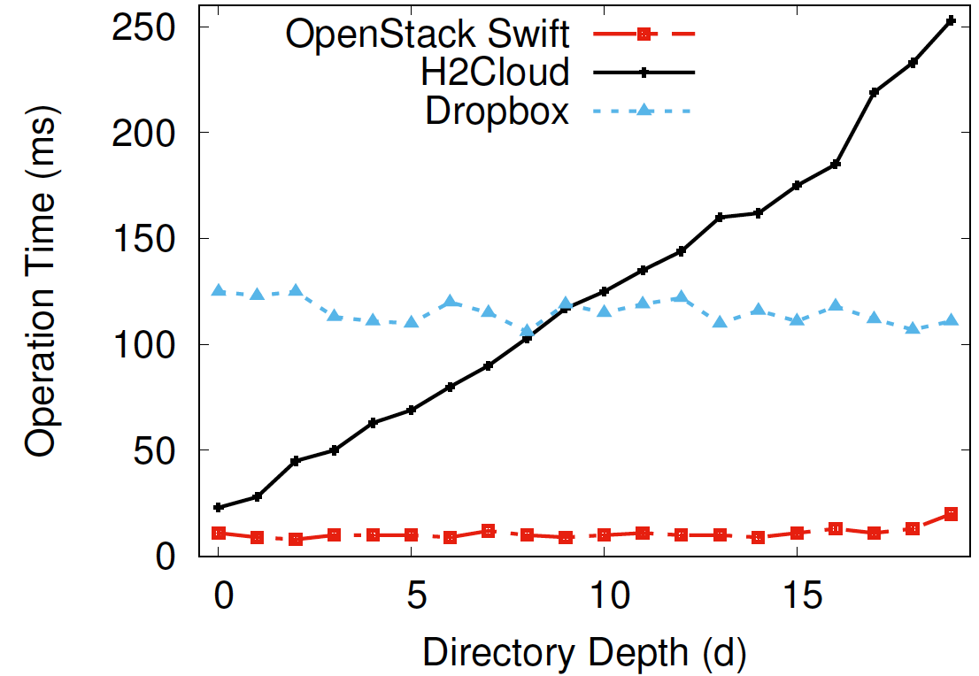
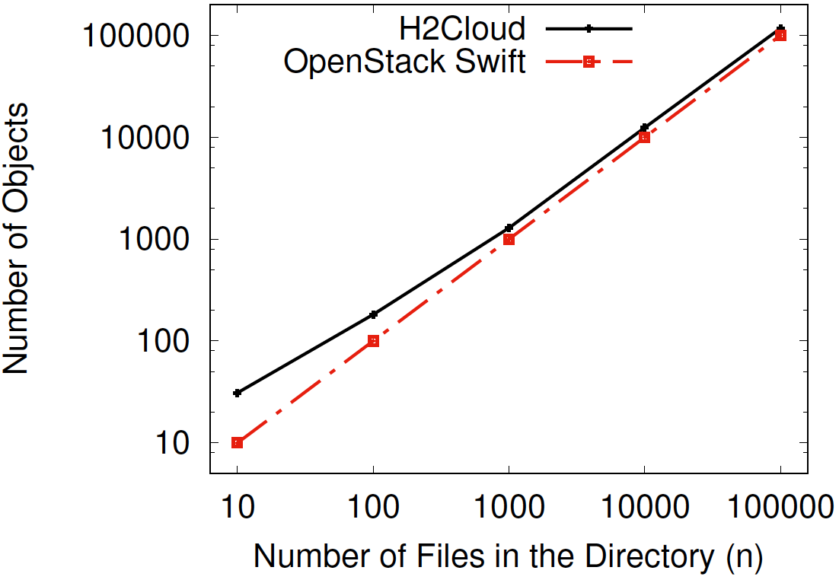
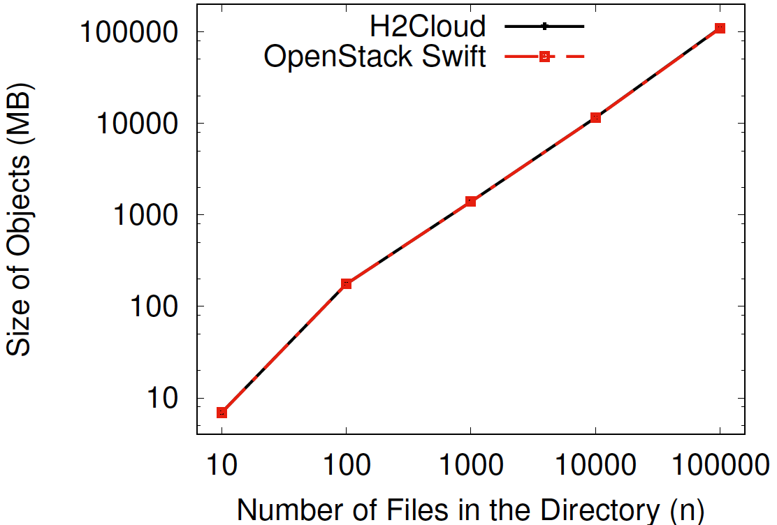
Operation time for file access (given the full file-path)
OpenStack Swift: stable, fastest
H2Cloud: Proportional to Directory depth
Storage Overhead
Notes:
First we demonstrate the operation time for file access with the full file-path provided, as we have known that H2cloud only requires constant time for accessing a file with relative path.
We can see the OpenStack Swift is the fastest and cost stably around 10ms, as it directly calculates the hash value of the full path and looks it up in a consistent hashing ring.
With regard to H2, it hashes the file path step by step instead of as a whole, so its file access time is proportional to the directory depth.
But nevertheless, it achieves accept performance.
As for the storage overhead, H2cloud only involves negligible extra storage overload to the underlying OpenStack Swift, both inters of the number and the size of objects.

Slide 17
Conclusion
Investigate the possibility of hosting users’ whole filesystems in an object storage cloud.
A Survey of the metadata management technique,
Design of the Hierarchical Hash (H2) data structure,
Coupled Algorithms,
Implementation of H2Cloud: a prototype system,
Comprehensive performance evaluations
Notes:
In this paper, we Investigate the possibility of hosting users’ whole filesystems in an object storage cloud.
In order to achieving this, we conduct a comprehensive survey of the metadata management technique, and fined none of the public available techniques can achieve our goal.
Actually now, we know the IBM Spectrum Storage have achieved this, but nevertheless we still do not know their technique details.

Slide 18
Thank you for attendance
Q&A

